Slide 1
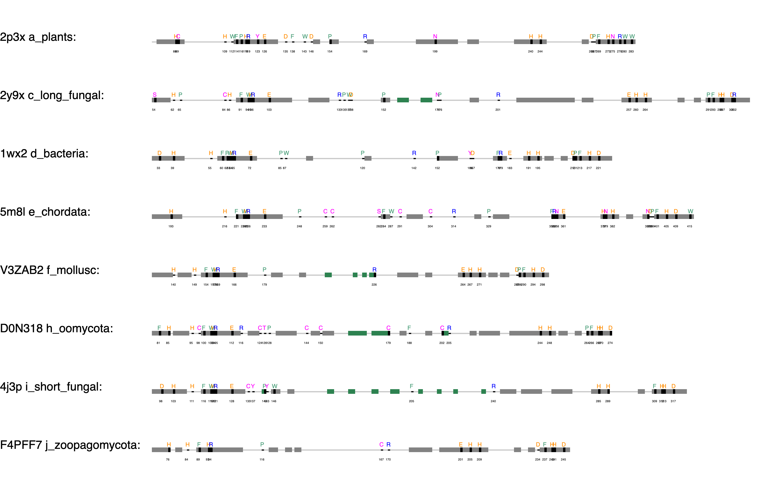
+84
+62
+32
+202
+130
+77
+93
aoco4
+68

Slide 2
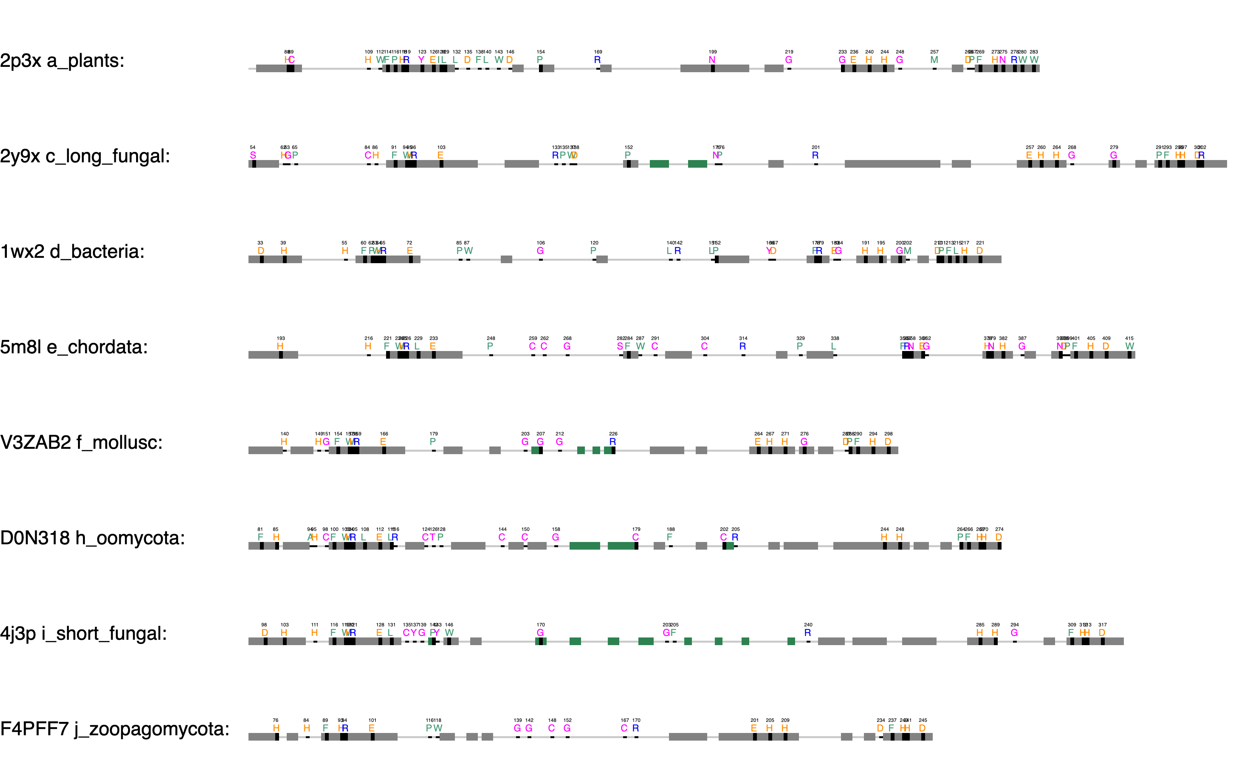
Thioether
Gatekeeper, F259, 68%, Kampatsikas
+84
+62
Blocker residue, Kanteev
+32
+202
First activity controller (HisB₁+1), Kampatsikas
+130
+77
aoco4
+93
+68
The seventh His (HisB₃-1), Kampatsikas

Slide 3

CuA binding motif
CuB binding motif
ppovv
+84
Gatekeeper, F259, 68%, Kampatsikas
Thioether
+62
Blocker residue, Kanteev
+32
+202
+130
First activity controller (HisB₁+1), Kampatsikas
+77
aoco4
+93
+68
The seventh His (HisB₃-1), Kampatsikas

Slide 4
a
b
c
d
e
f
g
h
i
j

Slide 6

Coupled binuclear copper (CBC) proteins
Hemocyanins
Polyphenol oxidases
O₂ transportation
Tyrosinases
Catechol oxidases
O-Aminophenol oxidase
Monooxygenase + 2 e⁻ oxidation
2 e⁻ oxidation
C-nitrosation

Slide 8
Hydroxylation
Gauiacol
Demethoxylation and hydroxylation
Methoxy-ortho-diphenol
Syrringol

